Slide 1

WEEK 3
CARBON CAPTURE AND STORAGE
Lecture 3

Slide 2

TOPIC OUTLINE
Ocean Storage

Slide 3
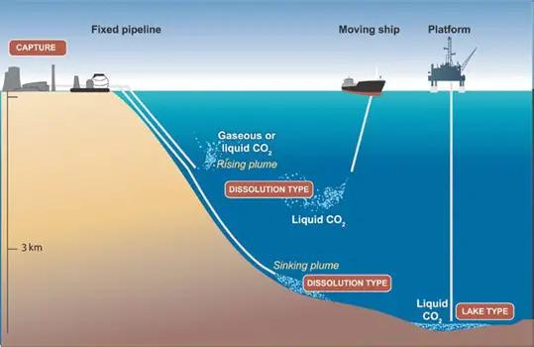
INTRODUCTION
A potential CO2 storage option is to inject captured CO2 directly into the deep ocean (at depths greater than 1,000 m), where most of it would be isolated from the atmosphere for centuries. This can be achieved by transporting CO2 via pipelines or ships to an ocean storage site, where it is injected into the water column of the ocean or at the sea floor. The dissolved and dispersed CO2 would subsequently become part of the global carbon cycle.

Slide 4
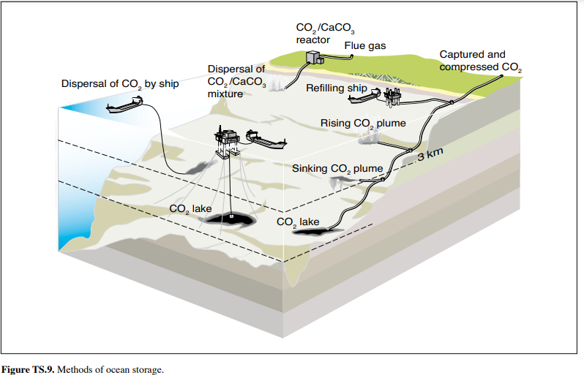
Ocean storage has not yet been deployed or demonstrated at a pilot scale, and is still in the research phase. However, there have been smallscale field experiments and 25 years of theoretical, laboratory and modelling studies of intentional ocean storage of CO2. Storage mechanisms and technology.

Slide 5
Oceans cover over 70% of the earth’s surface and their average depth is 3,800 m. Because carbon dioxide is soluble in water, there are natural exchanges of CO2 between the atmosphere and waters at the ocean surface that occur until equilibrium is reached. If the atmospheric concentration of CO2 increases, the ocean gradually takes up additional CO2.
In this way, the oceans have taken up about 500 GtCO2 (140 GtC) of the total 1,300 GtCO2 (350 GtC) of anthropogenic emissions released to the atmosphere over the past 200 years. As a result of the increased atmospheric CO2 concentrations from human activities relative to pre-industrial levels, the oceans are currently taking up CO2 at a rate of about 7 GtCO2 yr-1 (2 GtC yr-1).

Slide 6
Most of this carbon dioxide now resides in the upper ocean and thus far has resulted in a decrease in pH of about 0.1 at the ocean surface because of the acidic nature of CO2 in water. To date, however, there has been virtually no change in pH in the deep ocean. Models predict that over the next several centuries the oceans will eventually take up most of the CO2 released to the atmosphere as CO2 is dissolved at the ocean surface and subsequently mixed with deep ocean waters

Slide 7
There is no practical physical limit to the amount of anthropogenic CO2 that could be stored in the ocean. However, on a millennial time scale, the amount stored will depend on oceanic equilibration with the atmosphere. Stabilizing atmospheric CO2 concentrations between 350 ppmv and 1000 ppmv would imply that between 2,000 and 12,000 GtCO2 would eventually reside in the ocean if there is no intentional CO2 injection. This range therefore represents the upper limit for the capacity of the ocean to store CO2 through active injection. The capacity would also be affected by environmental factors, such as a maximum allowable pH change.

Slide 8
Analysis of ocean observations and models both indicate that injected CO2 will be isolated from the atmosphere for at least several hundreds of years, and that the fraction retained tends to be higher with deeper injection (see Table TS.7). Ideas for increasing the fraction retained include forming solid CO2 hydrates and/or liquid CO2 lakes on the sea floor, and dissolving alkaline minerals such as limestone to neutralize the acidic CO2. Dissolving mineral carbonates, if practical, could extend the storage time scale to roughly 10,000 years, while minimizing changes in ocean pH and CO2 partial pressure. However, large amounts of limestone and energy for materials handling would be required for this approach (roughly the same order of magnitude as the amounts per tonne of CO2 injected that are needed for mineral

Slide 9
ECOLOGICAL AND ENVIRONMENTAL IMPACTS AND RISKS
Injecting a few gigatonnes (Gt) of CO₂ into the ocean would alter local ocean chemistry, while hundreds of Gt would affect the entire ocean. Models predict that if ocean storage contributed 10% of the effort to stabilize CO₂ at 550 ppmv, acidity changes of more than 0.4 pH units would occur in about 1% of the ocean. Without ocean storage, a pH change of over 0.25 at the surface is expected. These changes are significantly greater than pre-industrial variations. Over centuries, ocean mixing will gradually release CO₂ back to the atmosphere, with no mechanisms for sudden releases.

Slide 10
ECOLOGICAL AND ENVIRONMENTAL IMPACTS AND RISKS
Experiments show that adding CO2 can harm marine organisms. Effects of elevated CO2 levels have mostly been studied on time scales up to several months in individual organisms that live near the ocean surface. Observed phenomena include reduced rates of calcification, reproduction, growth, circulatory oxygen supply and mobility, as well as increased mortality over time. In some organisms these effects are seen in response to small additions of CO2. Immediate mortality is expected close to injection points or CO2 lakes. The chronic effects of direct CO2 injection into the ocean on ocean organisms or ecosystems over large ocean areas and long time scales have not yet been studied.

Slide 11
ECOLOGICAL AND ENVIRONMENTAL IMPACTS AND RISKS
No controlled ecosystem experiments have been performed in the deep ocean, so only a preliminary assessment of potential ecosystem effects can be given. It is expected that ecosystem consequences will increase with increasing CO2 concentrations and decreasing pH, but the nature of such consequences is currently not understood, and no environmental criteria have as yet been identified to avoid adverse effects. At present, it is also unclear how or whether species and ecosystems would adapt to the sustained chemical changes.

Slide 12
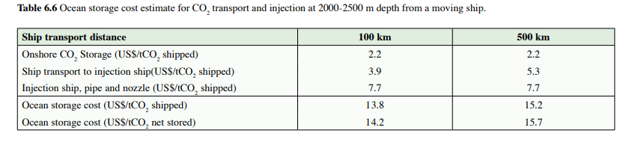
Costs of ocean storage-- Although there is no experience with ocean storage, some attempts have been made to estimate the costs of CO2 storage projects that release CO2 on the sea floor or in the deep ocean.

